Slide 1


Robotics &
Artificial Intelligence {AI}
Week 6

Slide 2
Learning Objectives
Robotics
Characteristics of Robots
Types of Robots
Uses of Robots
Artificial Intelligence
AI, ML & DL
Categories of ML
Computer Vision
Machine Vision
Computer Hardware & Software
Computer Programming

Slide 3
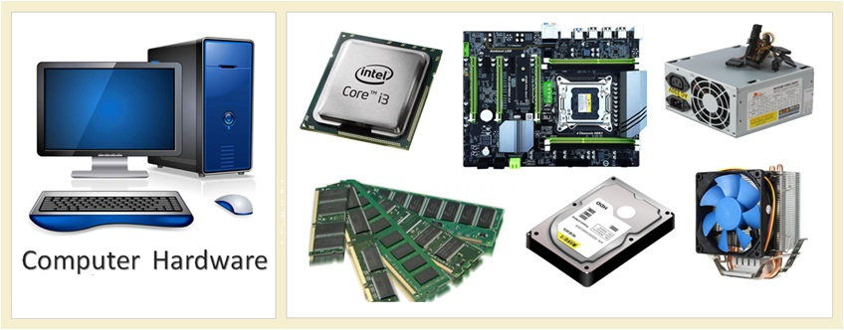
Computer Hardware
Computer hardware is any physical device used in or with your machine. Hardware is something you can hold in your hand.
If you opt to become a computer hardware engineer, your job could involve designing, testing or analyzing computer hardware, or overseeing the manufacturing process of computers and computerized equipment.

Slide 4
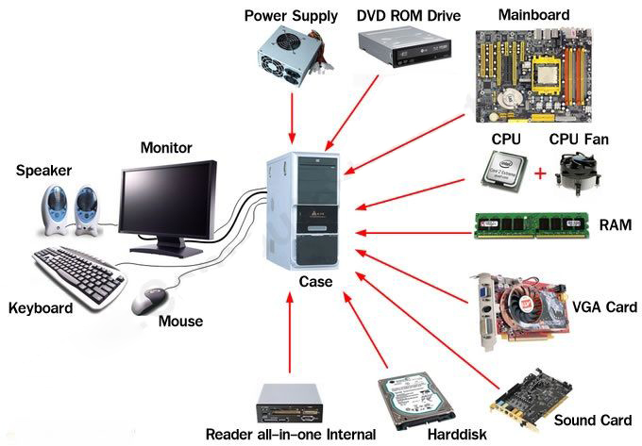
Computer Hardware

Slide 5
Benefits of Computer Hardware
Use at Workplace
Employment Opportunity
Enhance your Resume
Fast Skills Improvement

Slide 6

Computer Software
Software is a collection of programming code installed on your computer's hard drive.
It cannot be held in your hand.
It is virtual.

Slide 7
Benefits of Computer Software
Simplified decision making
More reliable data
Increase Productivity
Enhanced analysis
Improve data security
Better customer service
Increase sales potential

Slide 8
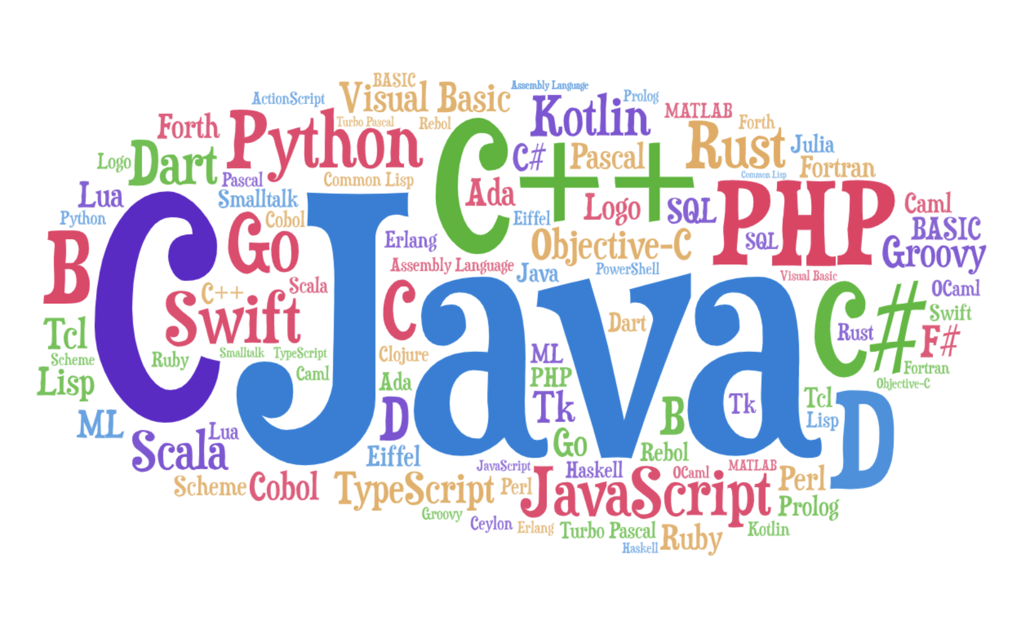
Computer Programming
Computer programming is a way of giving computers instructions about what they should do next.
These instructions are known as code, and computer programmers write code to solve problems or perform a task.

Slide 9
Benefits of Computer Programming
Creativity
Constantly Evolving Skill Set
Opportunities
Augmentation of Skill Set
Sense of accomplishment
Problem Solving
Work Remotely

Slide 10
Types of Programming Languages
Procedural Programming Language
Functional Programming Language
Object Oriented Programming Language
Scripting Programming Language

Slide 11
Procedural Programming Languages
Procedural Programming Language
Procedural programming language is used to execute a sequence of statements which lead to a result.
This type of programming language uses multiple variables, heavy loops and other elements, which separates them from functional programming languages.
Functions of procedural language may control variables, other than function’s value returns.

Slide 12
Types of Procedural Languages
Fortran
Cobol
Algo
Basic
C
Pascal

Slide 13
Functional Programming Language
Functional programming (also called FP) is a way of thinking about software construction by creating pure functions.
Typically uses stored data, frequently avoiding loops in favor of recursive functions.
FP emphasizes on expressions and declarations rather than execution of statements.
Unlike other procedures which depend on a local or global state, value output in FP depends only on the arguments passed to the function.
Functional Programming
Language

Slide 14
Characteristics of FP
Emphasis is on what is to be computed.
Data is immutable.
Functional programming decompose the problem into ‘functions.
It is built on the concept of mathematical functions which uses conditional expressions and recursion to do perform the calculation.
It does not support iteration like loop statements and conditional statements like If-Else
Functional programming method focuses on results, not the process.

Slide 15
Benefits of FP
Allows you to avoid confusing problems and errors in the code
Easier to test and execute Unit testing and debug FP Code.
Parallel processing and concurrency
Hot code deployment and fault tolerance
Offers better modularity with a shorter code
Increased productivity of the developer
Supports Nested Functions

Slide 16
Types of FP
Haskel
SML (Standard Meta Language)
Scala
F#
SQL
Clojure
Mathematica

Slide 17
Object Oriented Programming Language [OOP]
This programming language views the world as a group of objects that have internal data and external accessing parts of that data.
The aim is to think about the fault by separating it into a collection of objects that offer services which can be used to solve a specific problem.
One of the main principle of object oriented programming language is encapsulation that everything an object will need must be inside of the object.
This language also emphasizes reusability through inheritance and the capacity to spread current implementations without having to change a great deal of code by using polymorphism.
OOP

Slide 18
Structure Of OOP
Classes
Classes are user-defined data types that can act as the blueprint for individual objects, attributes and methods.
Methods are functions that are defined inside a class that describe the behaviors of an object. Each method contained in class definitions starts with a reference to an instance object.
Objects
Objects are instances of a class created with specifically defined data. Objects can respond to real-world objects or an abstract entity.
Methods
Attributes
Attributes are defined in the class template and represent the state of an object. Objects will have data stored in the attributes field. Class attributes belong to the class itself.

Slide 19
Benefits of OOP
Modularity
Reusability
Productivity
Easily upgradable and scalable
Interface descriptions
Security
Flexibility
Encapsulation enables objects to be self-contained, making troubleshooting and collaborative development easier.
Code can be reused through inheritance, meaning a team does not have to write the same code multiple times.
Programmers can construct new programs quicker through the use of multiple libraries and reusable code.
Programmers can implement system functionalities independently.
Descriptions of external systems are simple, due to message passing techniques that are used for objects communication.
Using encapsulation and abstraction, complex code is hidden, software maintenance is easier and internet protocols are protected.
Polymorphism enables a single function to adapt to the class it is placed in. Different objects can also pass through the same interface.

Slide 20
Types of OOP
Java
Python
C++
Visual Basic .NET
PHP
Ruby
Javascript

Slide 21
Scripting Programming Language
Scripting languages are a specific kind of computer languages that you can use to give instructions to other software, such as a web browser, server, or standalone application
They can perform different actions within a particular runtime environment, such as automating task execution, enhancing the functionality of the parent software, performing configurations and extracting data from data sets.
Scripting language (also known as scripting, or script) is a series of commands that are able to be executed without the need for compiling.
Scripting languages use a program known as an interpreter to translate commands and are directly interpreted from source code, not requiring a compilation step.
Scripting languages

Slide 22
Types of Scripting Languages
JavaScript
Groovy
Ruby
R
PHP
Python
Perl
PowerShell

Slide 23

Robotics & Artificial Intelligence
Robotics
Artificial Intelligence

Slide 24
Robotics
Robotics is the intersection of science, engineering and technology that produces machines, called robots, that substitute for (or replicate) human actions.

Slide 25

Robotics
Robotics involves design, construction, operation, and use of robots.
The goal of robotics is to design intelligent machines that can help and assist humans in their day-to-day lives and keep everyone safe.
Robots are programmable machines that are usually able to carry out a series of actions autonomously, or semi-autonomously.

Slide 26
Characteristics of a Robot
Robots consist of some sort of mechanical construction.
The mechanical aspect of a robot helps it complete tasks in the environment for which it’s designed.
Robots need electrical components that control and power the machinery.
An electric current ( e.g., a battery) is needed to power a large majority of robots.
Robots contain at least some level of computer programming.
Without a set of code telling it what to do, a robot would just be another piece of simple machinery.

Slide 27
Types of Robots
Pre-Programmed Robots
Humanoid Robots
Pre-programmed robots operate in a controlled environment where they do simple, monotonous tasks. An example of a pre-programmed robot would be a mechanical arm on an automotive assembly line.
Humanoid robots are robots that look like and/or mimic human behavior. These robots usually perform human-like activities (like running, jumping and carrying objects), and are sometimes designed to look like us, even having human faces and expressions.

Slide 28
Types of Robots
Autonomous Robots
Teleoperated Robots
Augmenting Robots
Autonomous robots operate independently of human operators. These robots are usually designed to carry out tasks in open environments that do not require human supervision.
Teleoperated robots are mechanical bots controlled by humans. These robots usually work in extreme geographical conditions, weather and circumstances.
Augmenting robots either enhance current human capabilities or replace the capabilities a human may have lost.

Slide 29
Uses of Robots
Manufacturing
Logistics
Home
Travel
Healthcare

Slide 30
Artificial Intelligence {AI}
Artificial intelligence (AI) is a branch of computer science that involves developing computer programs to complete tasks that would otherwise require human intelligence.
AI algorithms can tackle:
Perception
Learning
Problem Solving
Language Understanding
Logical Reasoning

Slide 31


What Can AI Control in Robotics?
AI is used to control robots, the AI algorithms are only part of the larger robotic system, which also includes sensors, actuators, and non-AI programming.
Often, but not always, AI involves some level of machine learning, where an algorithm is "trained" to respond to a particular input in a certain way by using known inputs and outputs.

Slide 32
AI, ML & DL
Machine Learning
Deep Learning
Artificial Intelligence

Slide 33
ML vs DL
Machine Learning
Deep Learning

Slide 34
Machine Learning
Machine learning refers to a type of data analysis that uses algorithms that learn from data.
It is a type of artificial intelligence (AI) that provides systems with the ability to learn without being explicitly programmed.
This enables computers to find data within data without human intervention.

Slide 35
Categories of ML
Supervised Machine Learning
Unsupervised Machine Learning
Reinforcement Learning
A pre-defined set of examples are used to reach a conclusion when given data.
The system finds patterns and relationships in the data with no examples from which to draw conclusions.
The system describes a class of problems where an agent operates in an environment and must learn to operate using feedback.

Slide 36
Deep Learning
Deep learning is a type of machine learning and artificial intelligence (AI) that imitates the way humans gain certain types of knowledge.
Deep learning is an important element of data science, which includes statistics and predictive modeling.
It is extremely beneficial to data scientists who are tasked with collecting, analyzing and interpreting large amounts of data; deep learning makes this process faster and easier.

Slide 37
Computer Vision vs Machine Vision
Computer Vision
Machine Vision

Slide 38
Computer Vision
Computer Vision refers to automation of the capture and processing of images, with an emphasis on image analysis. In other words, CV’s goal is not only to see, but also to process and provide useful results based on the observation.
Computer vision is a field of artificial intelligence (AI) that enables computers and systems to derive meaningful information from digital images, videos and other visual inputs — and take actions or make recommendations based on that information.

Slide 39
Machine Vision
Machine vision is a technology that enables automatic inspection and analysis for applications including automatic inspection, process control, and robotic guidance by using image processing.
Machine vision refers to many technologies, software and hardware products, integrated systems, actions, methods and expertise.

Slide 40
CV versus MV
FEATURES | MACHINE VISION | COMPUTER VISION
Motivation | Practical | Academic
Cost | Critical | Likely to be of secondary importance
Input data | A piece of metal, plastic, glass, wood, etc. | Computer file
Nature of acceptable solution | Satisfactory performance | Optimal performance
Output data | Simple signal, to control external equipment | Complex signal, for human being

Slide 41


Thank You
Q & A
www.pau.edu.ng
pau_Nigeria
Pan-Atlantic University

